Slide 1
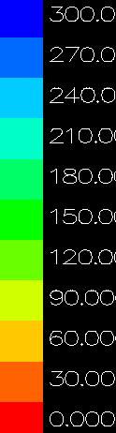
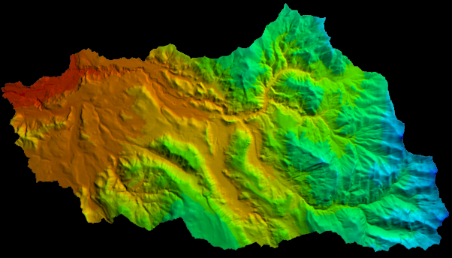
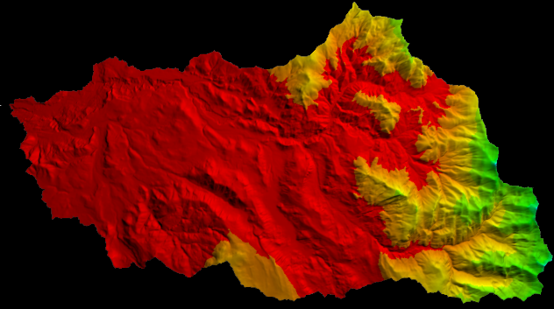
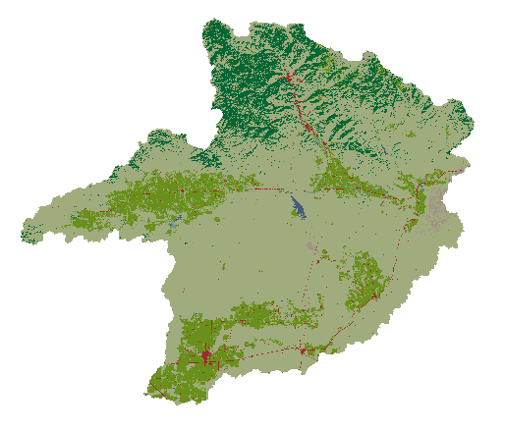
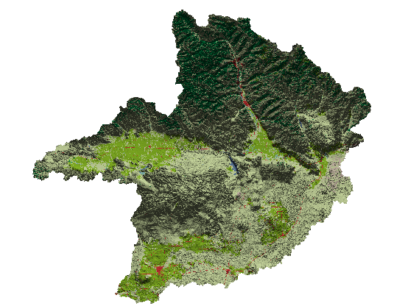
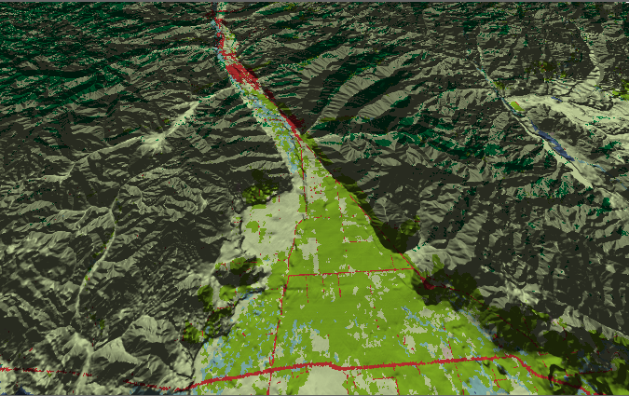
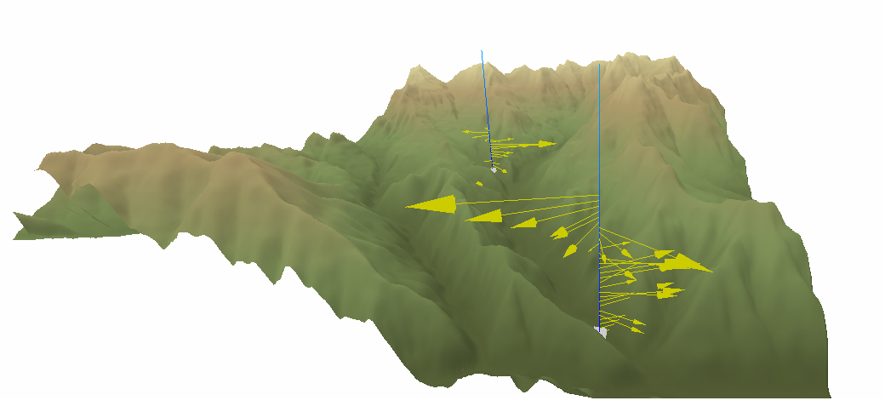
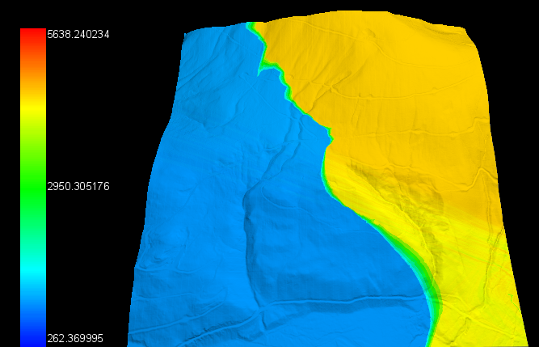
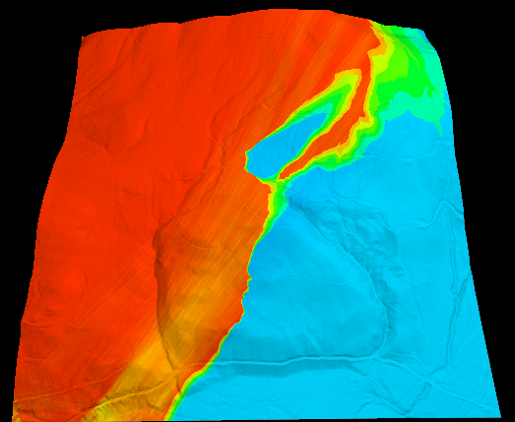
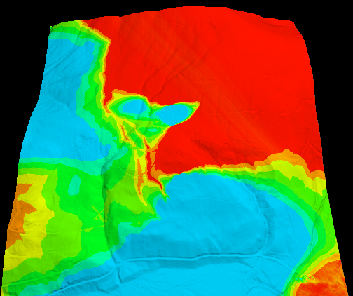





Visualizing Terrestrial and Aquatic Systems in 3D Stills, Fly-throughs and Animations of Complex Topography
Mike Bailey, John Bolte, Jonathan Halama, Denise Lach, Christoph Thomas, Kirsten Winters, Chad Zanocco
Oregon State University, Corvallis OR USA
Judith B. Cushing judyc@evergreen.edu The Evergreen State College, Olympia WA
Genevieve Orr Willamette University, Salem OR
Robert McKane, Allen Brookes EPA Western Ecology Division, Corvallis OR
Nik Stevenson-Molnar, Taylor Mutch Dominique Bachelet Conservation Biology Institute, Corvallis OR
http://blogs.evergreen.edu/vistas
Susan Stafford, Univ, Minnesota, St. Paul MN
About VISTAS
Current Status
The Future – Visual Analytics
Grand challenge environmental science problems involve large data sets spanning multiple spatial and temporal scales, with complex, highly distributed, heterogeneous data. Visualizing natural phenomena helps scientists formulate new insights, tune models, and communicate results, but ecologists rarely use sophisticated visualization tools. We ask why not.
The VISualization of Terrestrial and Aquatic Systems (VISTAS) project, an NSF-funded collaboration among ecologists, computer scientists, and social scientists aims is to help scientists better understand and communicate grand challenge environmental science through visual analytics, in particular 3D interfactive topographic images.
VISTAS focuses on 3D topographical visualizations over time and perspective. To date, we superimpose measured or modeled variables on digital elevation models and allow collaborators to view and interact with single frames, animations, or multiple images. This poster presents visualizations of scientific teams whose data (at different scales) might be enhanced with visualizations of each other’s data on the same canvas for cross-scale visualizations. Each image elucidates one or more concepts that might be better conveyed using VISTAS than with prior tools: 3D terrain, enhanced topography, interactive perspective browsing and manipulation, animation over time, side-by-side viewing of data at different points in time or different attributes.
VISTAS is implemented in C++ and OpenGL, with modular, scalable design, and is freely available (source and executables) from http://blogs.evergreen.edu/vistas.
VISTAS collaborators report that some data are more effective when superimposed on 3D topography than when seen as 2D maps, and leads to new ways of thinking about how ecosystems respond to stress.
Social scientists are asking which visualizations work, for which purposes, for which audiences. We just received new NSF funding to explore using visualizations to bring communities together with scientists to co-develop climate change adaptation strategies.
Models and remote sensing both produce data streams too large even to view on one screen. We are exploring machine learning techniques to help our collaborators categorize data and zoom in on critical changes in landscapes. Statistical charts, coordinated in time and space with the scientific visualizations, are also next steps for VISTAS.
ASK TO SEE
ANIMATIONS AND LIVE DEMO’S!
Hydro-Biogeochemical Processes
VELMA
Modeling Irradiance
Penumbra
Alternative Land Use
ENVISION
Airflows in Mountain Valleys Micrometeorology
Following the Sun at Mt. Gardner, WA July 6, 2013
Wind Direction and Speed HJ Andrews LTER
3D VISTAS animation helps Jonathan Halama (OSU Ph.D. Candidate) fine-tune and validate his Irradiance model and then create images to illustrate changes in light at ground level as shaded by vegetation at this Snotel Site .
A WebGL VISTAS prototype helps explain how wind speed and direction vary over complex topographical landscapes, and how flow patterns affect atmospheric transport of nutrients and pollutants.
Mashel Watershed Snow Depth (SWE) Feb 4 & 9, 1996 Begin & After Rain-on-Snow Event
VISTAS 3D stills help Bob McKane (EPA Corvallis) illustrate snow melt influences on hydrology and aid in Salmon Recover Planning for the Nisqually Watershed Council.
Vegetative Cover & Land Use Big Wood Basin, Idaho
Ecologist Allison Inouye used VISTAS to show land use futures near Sun Valley. Above (left) 2D image vs. (right) 3D image.
Below: Still from VISTAS fly-through.
VISTAS’ focus is data from HJ Andrews Long Term Ecological Research (LTER) Site in the Cascade Mountains, Oregon, USA.
.
Poster prepared for
2016 HJA Symposium
Corvallis, OR
VISTAS is funded by NSF BIO/DBI 1062572, 0940748,
CIS/IIS 0940748, 0917708 and an HJA LTER ROA
For more information visit http://blogs.evergreen.edu/vistas
or contact: judyc@evergreen.edu
Evergreen

